Slide 1
EE4620 –Spectral Domain Methods
Far Field Evaluation
MATLAB Instruction
6 May. 2020

Slide 2
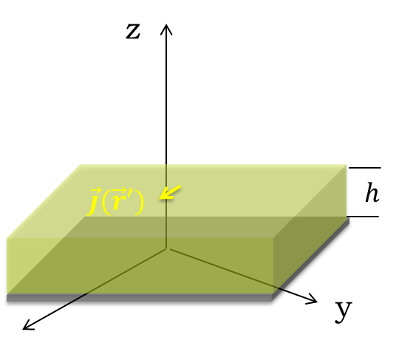
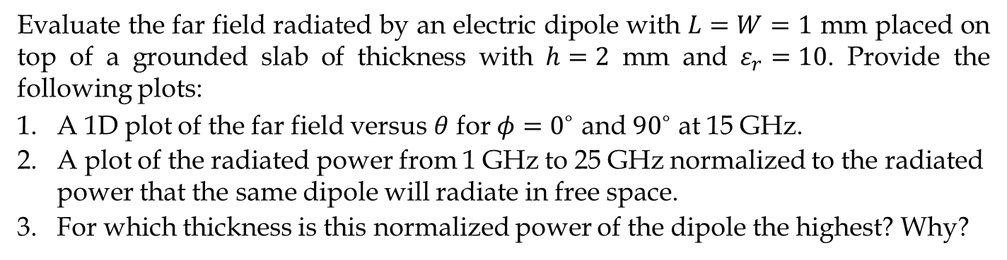
Question 1 (3 points)
Evaluate the far field radiated by an electric dipole with $L=W=1$ mm placed on top of a grounded slab of thickness with $h=2$ mm and $ε_{r}=10$. Provide the following plots:
A 1D plot of the far field versus $θ$ for $φ=0^{∘}$ and ${90}^{∘}$ at 15 GHz.
A plot of the radiated power from 1 GHz to 25 GHz normalized to the radiated power that the same dipole will radiate in free space.
For which thickness is this normalized power of the dipole the highest? Why?
Spectral Domain Methods

Slide 3
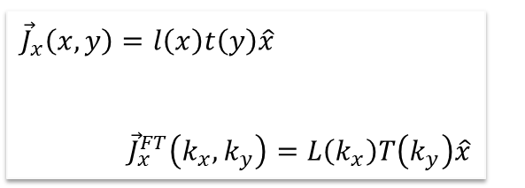
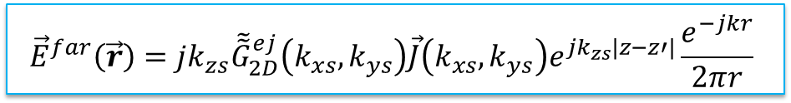
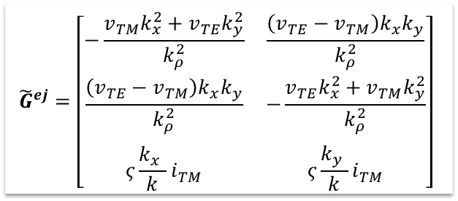
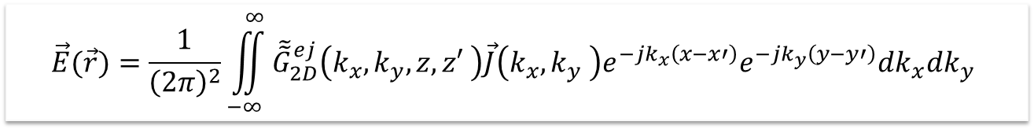



Far-field evaluation
The far field radiated by a certain current distribution can be calculated in spectral domain as follows:
$$\vec{E}(\vec{r})=\frac{1}{{\left(2π\right)}^{2}}\iint_{−∞}^{∞}{{\tilde{\tilde{G}}}_{2D}^{ej}\left(k_{x},k_{y},z,z′ \right)\vec{J}\left(k_{x},k_{y} \right)e^{−jk_{x}\left(x−x′\right)}e^{−jk_{y}\left(y−y′\right)}dk_{x}dk_{y}}$$
$$k_{xs}=k_{0}sinθcosφ$$
The integral is dominated by a single plane wave (direct ray from the source to the observation point)
$$k_{ys}=k_{0}sinθsinφ$$
$$k_{zs}=k_{0}cosθ$$
$${\vec{E}}^{far}\left(\vec{r}\right)=jk_{zs}{\tilde{\tilde{G}}}_{2D}^{ej}\left(k_{xs},k_{ys}\right)\vec{J}\left(k_{xs},k_{ys}\right)e^{jk_{zs}|z−z′|}\frac{e^{−jkr}}{2πr}$$
Step 1
Step 2
$${\tilde{G}}^{ej}=\left[\begin{matrix}−\frac{v_{TM}k_{x}^{2}+v_{TE}k_{y}^{2}}{k_{ρ}^{2}} & \frac{\left(v_{TE}−v_{TM}\right)k_{x}k_{y}}{k_{ρ}^{2}} \\ \frac{\left(v_{TE}−v_{TM}\right)k_{x}k_{y}}{k_{ρ}^{2}} & −\frac{{v_{TE}k_{x}^{2}+v}_{TM}k_{y}^{2}}{k_{ρ}^{2}} \\ ς\frac{k_{x}^{}}{k}i_{TM}^{} & ς\frac{k_{y}^{}}{k}i_{TM}^{}\end{matrix}\right]$$
$${\vec{J}}_{x}\left(x,y\right)=l\left(x\right)t\left(y\right)\hat{x}$$
$${\vec{J}}_{x}^{FT}\left(k_{x},k_{y}\right)=L\left(k_{x}\right)T\left(k_{y}\right)\hat{x}$$
FT
Spectral Domain Methods

Slide 4
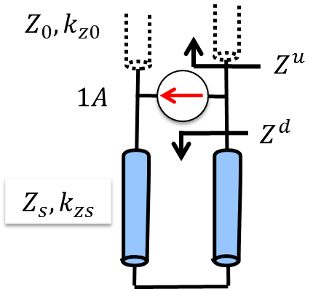
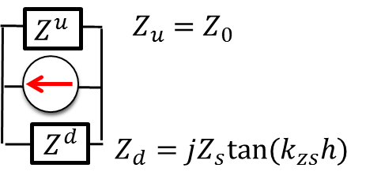
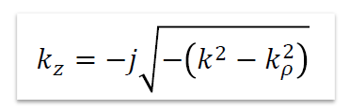



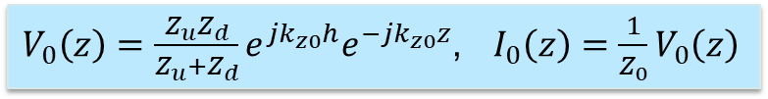

Dyadic SGF
$${\tilde{G}}^{ej}=\left[\begin{matrix}−\frac{v_{TM}k_{x}^{2}+v_{TE}k_{y}^{2}}{k_{ρ}^{2}} & \frac{\left(v_{TE}−v_{TM}\right)k_{x}k_{y}}{k_{ρ}^{2}} \\ \frac{\left(v_{TE}−v_{TM}\right)k_{x}k_{y}}{k_{ρ}^{2}} & −\frac{{v_{TE}k_{x}^{2}+v}_{TM}k_{y}^{2}}{k_{ρ}^{2}} \\ ς\frac{k_{x}^{}}{k}i_{TM}^{} & ς\frac{k_{y}^{}}{k}i_{TM}^{}\end{matrix}\right]$$
Tx. line solution
$$v_{TM},v_{TE},i_{TM},i_{TE}$$
Equivalent transmission line
$$Z_{TE}=\frac{ζk}{k_{z}}$$
$$Z_{TM}=\frac{ζk_{z}}{k}$$
Voltage and current in the air:
$V_{0}\left(z\right)=\frac{Z_{u}Z_{d}}{Z_{u}+Z_{d}}e^{jk_{z0}h}e^{−jk_{z0}z}$, $I_{0}\left(z\right)=\frac{1}{Z_{0}}V_{0}\left(z\right)$
Spectral Domain Methods

Slide 5
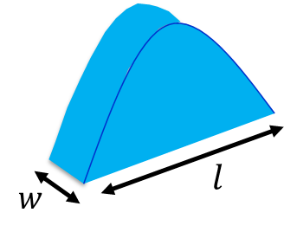
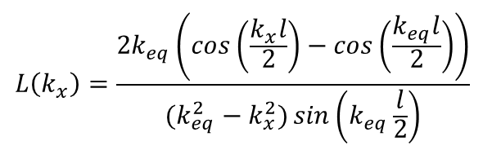



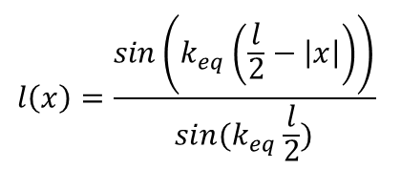
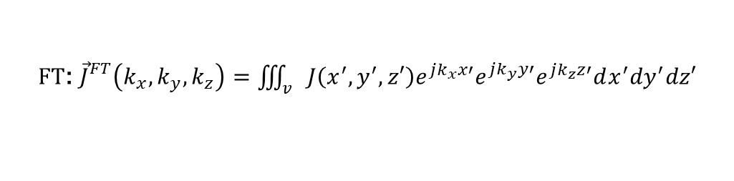

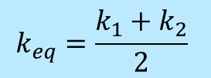
FT of currents
For dipole antennas, we can approximate the spatial current distribution using the current distribution along an open circuited transmission line. This distribution can be expressed in general as follows:
FT
$${\tilde{J}}_{x}\left(k_{x},k_{y}\right)=L\left(k_{x}\right)T\left(k_{y}\right)$$
$$J_{x}\left(x,y\right)=l\left(x\right)t\left(y\right)$$
$$t\left(y\right)=\frac{1}{w}rect(y,w)$$
$$T\left(k_{y}\right)=sinc(\frac{k_{y}w}{2})$$
$$l\left(x\right)=\frac{\sin\left(k_{eq}\left(\frac{l}{2}−\left|x\right|\right)\right)}{sin⁡(k_{eq}\frac{l}{2})}$$
$$L\left(k_{x}\right)=\frac{2k_{eq}\left(cos\left(\frac{k_{x}l}{2}\right)−cos\left(\frac{k_{eq}l}{2}\right)\right)}{(k_{eq}^{2}−k_{x}^{2})\sin\left(k_{eq}\frac{l}{2}\right)}$$
$$k_{eq}=\frac{k_{1}+k_{2}}{2}$$
FT: ${\vec{J}}_{}^{FT}\left(k_{x},k_{y},k_{z}\right)=\iiint_{v}{J\left(x^{′},y^{′},z′\right)e^{jk_{x}x′}e^{jk_{y}y′}e^{jk_{z}z′}dx^{′}dy^{′}dz′}$
Spectral Domain Methods

Slide 6
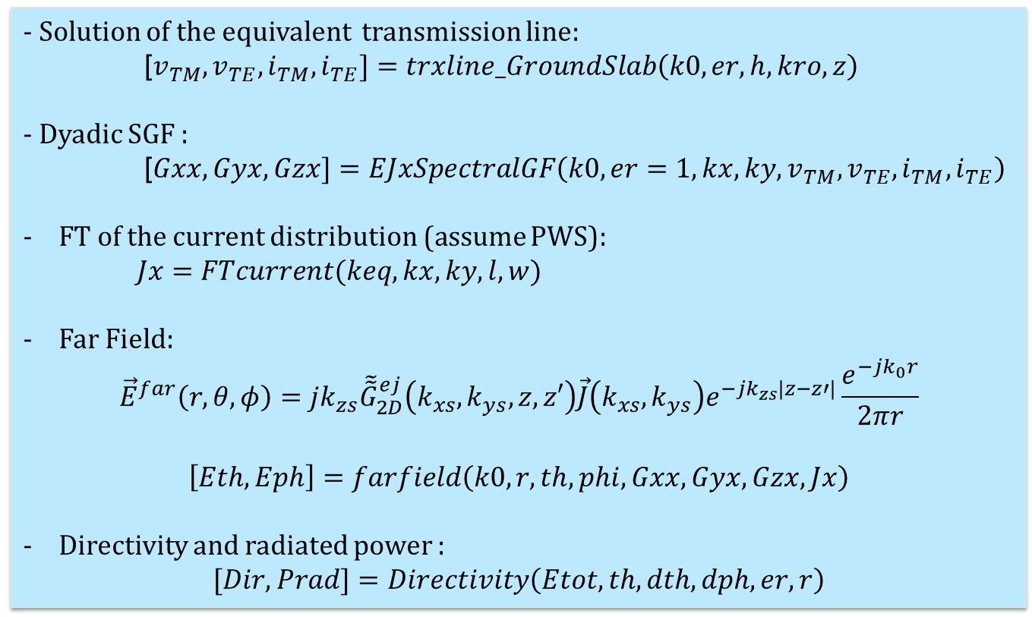
Routines
- Solution of the equivalent transmission line:
[$v_{TM},v_{TE},i_{TM},i_{TE}]=trxline_GroundSlab\left(k0,er,h,kro,z\right)$
- Dyadic SGF :
[$Gxx,Gyx,Gzx]=EJxSpectralGF\left(k0,er=1,kx,ky,v_{TM},v_{TE},i_{TM},i_{TE}\right)$
FT of the current distribution (assume PWS):
$Jx=FTcurrent(keq,kx,ky,l,w)$
Far Field:
$${\vec{E}}^{far}\left(r,θ,φ\right)=jk_{zs}{\tilde{\tilde{G}}}_{2D}^{ej}\left(k_{xs},k_{ys},z,z′\right)\vec{J}\left(k_{xs},k_{ys}\right)e^{−jk_{zs}|z−z′|}\frac{e^{−jk_{0}r}}{2πr}$$
$$\left[Eth,Eph\right]=farfield\left(k0,r,th,phi,Gxx,Gyx,Gzx,Jx\right)$$
Directivity and radiated power :
$$[Dir, Prad]=Directivity\left(Etot, th,dth,dph,er,r\right)$$
Spectral Domain Methods

Slide 7
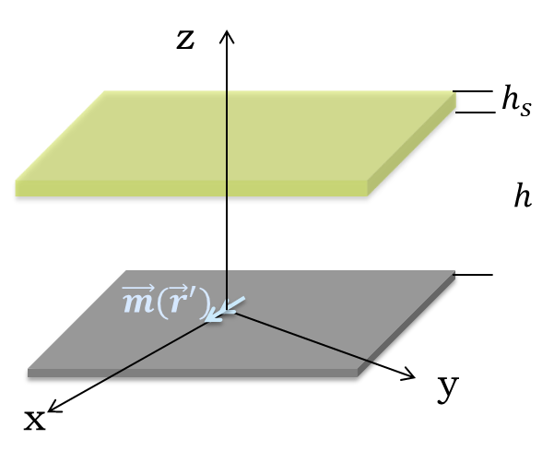
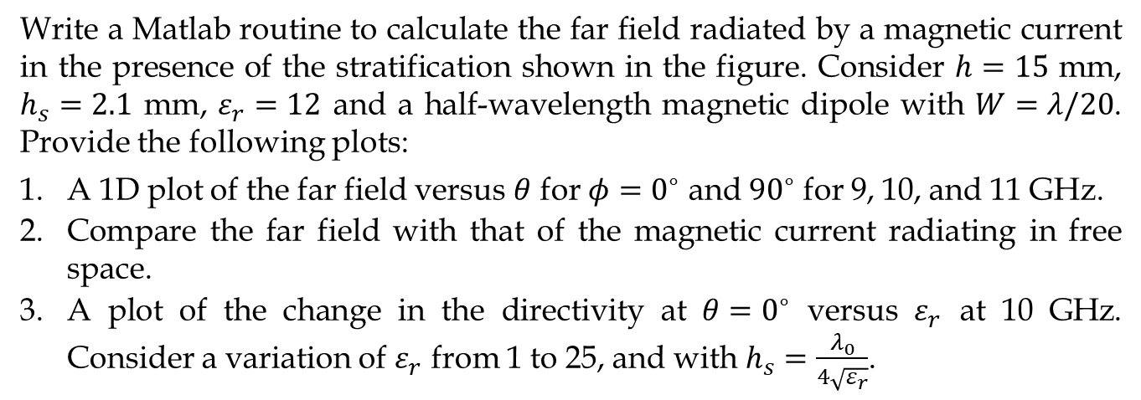
Question 2 (4 points)
Write a Matlab routine to calculate the far field radiated by a magnetic current in the presence of the stratification shown in the figure. Consider $h=15$ mm, $h_{s}=2.1$ mm, $ε_{r}=12$ and a half-wavelength magnetic dipole with $W=λ/20$. Provide the following plots:
A 1D plot of the far field versus $θ$ for $φ=0^{∘}$ and ${90}^{∘}$ for 9, 10, and 11 GHz.
Compare the far field with that of the magnetic current radiating in free space.
A plot of the change in the directivity at $θ=0^{∘}$ versus $ε_{r}$ at 10 GHz. Consider a variation of $ε_{r}$ from 1 to 25, and with $h_{s}=\frac{λ_{0}}{4\sqrt{ε_{r}}}$.
Spectral Domain Methods

Slide 8
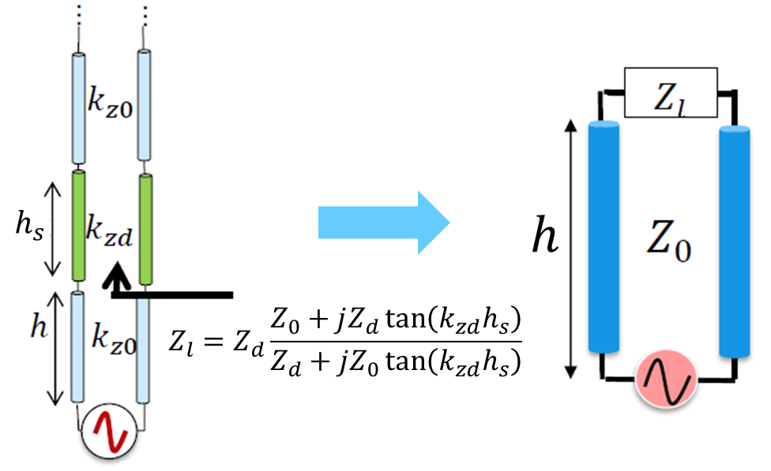
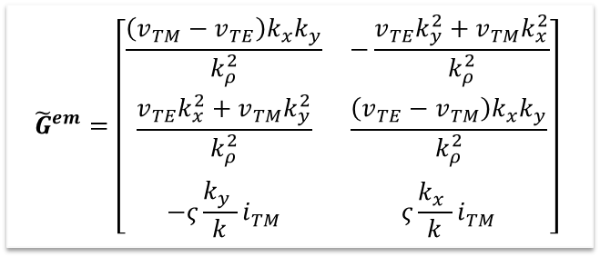
Dyadic SGF
$${\tilde{G}}^{em}=\left[\begin{matrix}\frac{\left(v_{TM}−v_{TE}\right)k_{x}k_{y}}{k_{ρ}^{2}} & −\frac{{v_{TE}k_{y}^{2}+v}_{TM}k_{x}^{2}}{k_{ρ}^{2}} \\ \frac{{v_{TE}k_{x}^{2}+v}_{TM}k_{y}^{2}}{k_{ρ}^{2}} & \frac{\left(v_{TE}−v_{TM}\right)k_{x}k_{y}}{k_{ρ}^{2}} \\ −ς\frac{k_{y}^{}}{k}i_{TM}^{} & ς\frac{k_{x}^{}}{k}i_{TM}^{}\end{matrix}\right]$$
Tx. line solution
$$v_{TM},v_{TE},i_{TM},i_{TE}$$
Equivalent transmission line
Spectral Domain Methods

Slide 9
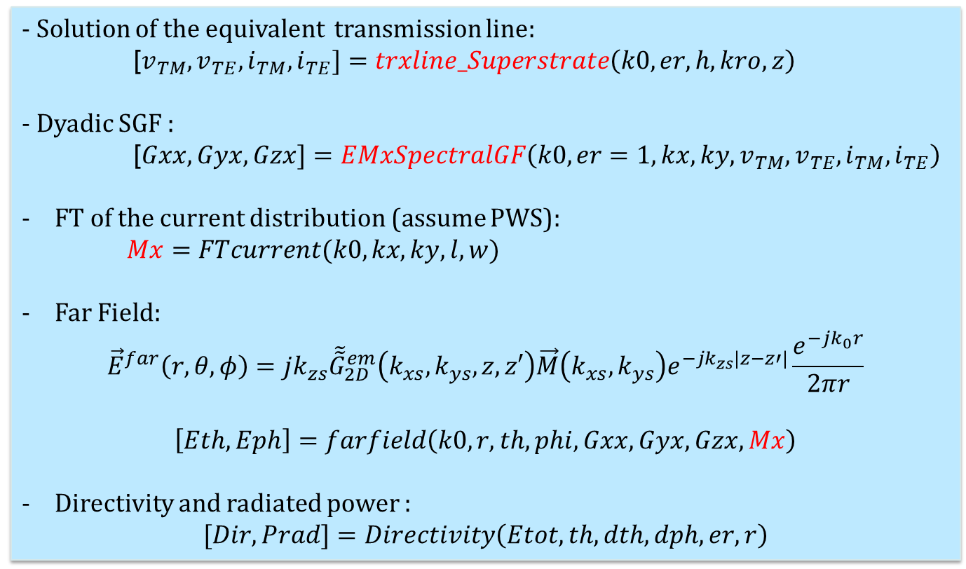
Routines
- Solution of the equivalent transmission line:
[$v_{TM},v_{TE},i_{TM},i_{TE}]=trxline_Superstrate\left(k0,er,h,kro,z\right)$
- Dyadic SGF :
[$Gxx,Gyx,Gzx]=EMxSpectralGF\left(k0,er=1,kx,ky,v_{TM},v_{TE},i_{TM},i_{TE}\right)$
FT of the current distribution (assume PWS):
$Mx=FTcurrent(k0,kx,ky,l,w)$
Far Field:
$${\vec{E}}^{far}\left(r,θ,φ\right)=jk_{zs}{\tilde{\tilde{G}}}_{2D}^{em}\left(k_{xs},k_{ys},z,z′\right)\vec{M}\left(k_{xs},k_{ys}\right)e^{−jk_{zs}|z−z′|}\frac{e^{−jk_{0}r}}{2πr}$$
$$\left[Eth,Eph\right]=farfield\left(k0,r,th,phi,Gxx,Gyx,Gzx,Mx\right)$$
Directivity and radiated power :
$$[Dir, Prad]=Directivity\left(Etot, th,dth,dph,er,r\right)$$
Spectral Domain Methods

Slide 10
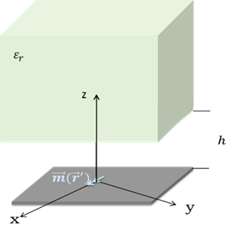
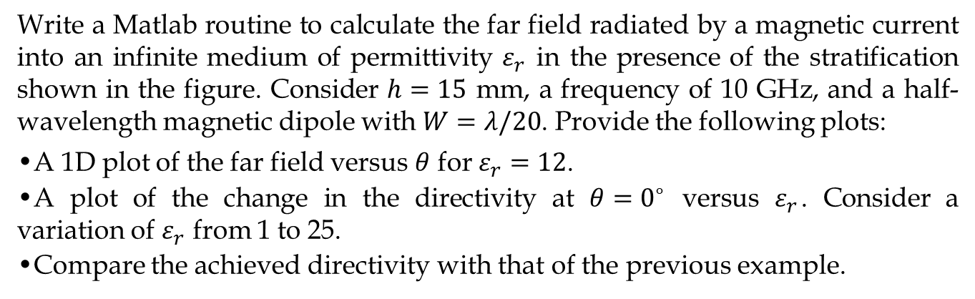
Question 3 (3 points)
Write a Matlab routine to calculate the far field radiated by a magnetic current into an infinite medium of permittivity $ε_{r}$ in the presence of the stratification shown in the figure. Consider $h=15$ mm, a frequency of 10 GHz, and a half-wavelength magnetic dipole with $W=λ/20$. Provide the following plots:
A 1D plot of the far field versus $θ$ for $ε_{r}=12$.
A plot of the change in the directivity at $θ=0^{∘}$ versus $ε_{r}$. Consider a variation of $ε_{r}$ from 1 to 25.
Compare the achieved directivity with that of the previous example.
Spectral Domain Methods

Slide 11
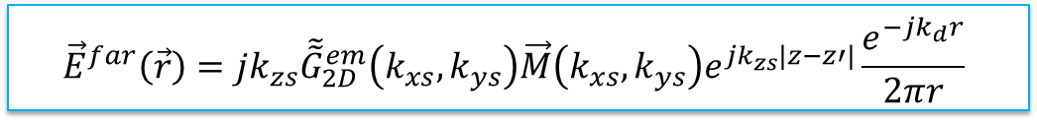
Far-field evaluation
The most important change is that the far field is now radiated inside a dielectric medium. The spectral parameters should be:
$k_{xs}=k_{0}\sqrt{ε_{r}}sinθcosφ$, $k_{ys}=k_{0}\sqrt{ε_{r}}sinθsinφ,$ $k_{zs}=k_{0}\sqrt{ε_{r}}cosθ$
$${\vec{E}}^{far}\left(\vec{r}\right)=jk_{zs}{\tilde{\tilde{G}}}_{2D}^{em}\left(k_{xs},k_{ys}\right)\vec{M}\left(k_{xs},k_{ys}\right)e^{jk_{zs}|z−z′|}\frac{e^{−jk_{d}r}}{2πr}$$
Spectral Domain Methods

Slide 12
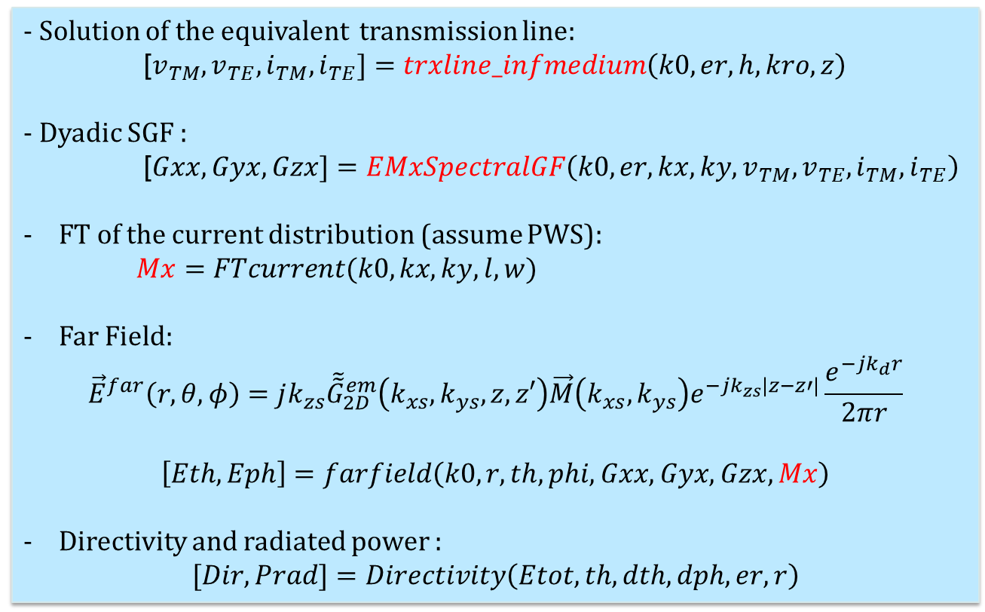
Routines
- Solution of the equivalent transmission line:
[$v_{TM},v_{TE},i_{TM},i_{TE}]=trxline_infmedium\left(k0,er,h,kro,z\right)$
- Dyadic SGF :
[$Gxx,Gyx,Gzx]=EMxSpectralGF\left(k0,er,kx,ky,v_{TM},v_{TE},i_{TM},i_{TE}\right)$
FT of the current distribution (assume PWS):
$Mx=FTcurrent(k0,kx,ky,l,w)$
Far Field:
$${\vec{E}}^{far}\left(r,θ,φ\right)=jk_{zs}{\tilde{\tilde{G}}}_{2D}^{em}\left(k_{xs},k_{ys},z,z′\right)\vec{M}\left(k_{xs},k_{ys}\right)e^{−jk_{zs}|z−z′|}\frac{e^{−jk_{d}r}}{2πr}$$
$$\left[Eth,Eph\right]=farfield\left(k0,r,th,phi,Gxx,Gyx,Gzx,Mx\right)$$
Directivity and radiated power :
$$[Dir, Prad]=Directivity\left(Etot, th,dth,dph,er,r\right)$$
Spectral Domain Methods

Slide 13
Contact
E-mail: H.Zhang-12@tudelft.nl
Zoom: search Huasheng zhang using TU delft account
Spectral Domain Methods

